Slide 1
Marketing performance overview
Name of course here
12th June, 2025

Slide 2
Executive summary
3 bullets on overall performance
(e.g. “Exceeded lead targets by 20% QoQ”, “Brand awareness up 15%”, “New team structure delivered faster campaigns”)
Bullet #2
Short overview to go here
Bullet #3
Short overview to go here

Slide 3
Key takeaway
Marketing is [on-track / over-performing / facing headwinds]

Slide 4
Marketing goals vs results
Goal | Target | Result | Commentary
E.g. Increase MQLs for [insert product] | 10% | 9% | Provide context behind the win/shortfall
E.g. Increase SQLs for [insert product] | 15% | 17%
E.g. Increase pipeline for [insert product] | $100,000 | $88,000
E.g. Reduce CAC for [insert product] | 1% | 1.2%

Slide 5
Key campaigns and results
[Insert timeframe]

Slide 6
#1: [insert campaign name]
Goal
What was done
Outcome
E.g. Generate £1.2M in qualified pipeline and increase product adoption by 25% within 3 months of launch.
E.g. Ran a 6-week integrated campaign targeting mid-market tech companies. Included:
- LinkedIn and Google Ads
- 3-part email sequence to existing leads
- Launch webinar with product walkthrough
- Sales enablement pack for BDR team
Created landing page with dynamic personalisation based on industry.
E.g.
- £1.6M in sourced pipeline (33% above target)
- Product adoption increased by 29%
- 1,200 webinar registrants, 350 attendees
- Sales accepted 64% of MQLs (up from previous 42%)

Slide 7
Key learning
Investing in content up front is the way to go.
E.g. Highly targeted messaging and enablement material for sales significantly improved conversion from MQL to SQL. Investing in content up front led to fewer drop-offs and better post-launch traction.

Slide 8
#2: [insert campaign name]
Goal
What was done
Outcome
E.g. Generate £1.2M in qualified pipeline and increase product adoption by 25% within 3 months of launch.
E.g. Ran a 6-week integrated campaign targeting mid-market tech companies. Included:
- LinkedIn and Google Ads
- 3-part email sequence to existing leads
- Launch webinar with product walkthrough
- Sales enablement pack for BDR team
Created landing page with dynamic personalisation based on industry.
E.g.
- £1.6M in sourced pipeline (33% above target)
- Product adoption increased by 29%
- 1,200 webinar registrants, 350 attendees
- Sales accepted 64% of MQLs (up from previous 42%)

Slide 9
Key learning
Investing in content up front is the way to go.
E.g. Highly targeted messaging and enablement material for sales significantly improved conversion from MQL to SQL. Investing in content up front led to fewer drop-offs and better post-launch traction.

Slide 10
#3: [insert campaign name]
Goal
What was done
Outcome
E.g. Generate £1.2M in qualified pipeline and increase product adoption by 25% within 3 months of launch.
E.g. Ran a 6-week integrated campaign targeting mid-market tech companies. Included:
- LinkedIn and Google Ads
- 3-part email sequence to existing leads
- Launch webinar with product walkthrough
- Sales enablement pack for BDR team
Created landing page with dynamic personalisation based on industry.
E.g.
- £1.6M in sourced pipeline (33% above target)
- Product adoption increased by 29%
- 1,200 webinar registrants, 350 attendees
- Sales accepted 64% of MQLs (up from previous 42%)

Slide 11
Key learning
Investing in content up front is the way to go.
E.g. Highly targeted messaging and enablement material for sales significantly improved conversion from MQL to SQL. Investing in content up front led to fewer drop-offs and better post-launch traction.

Slide 12
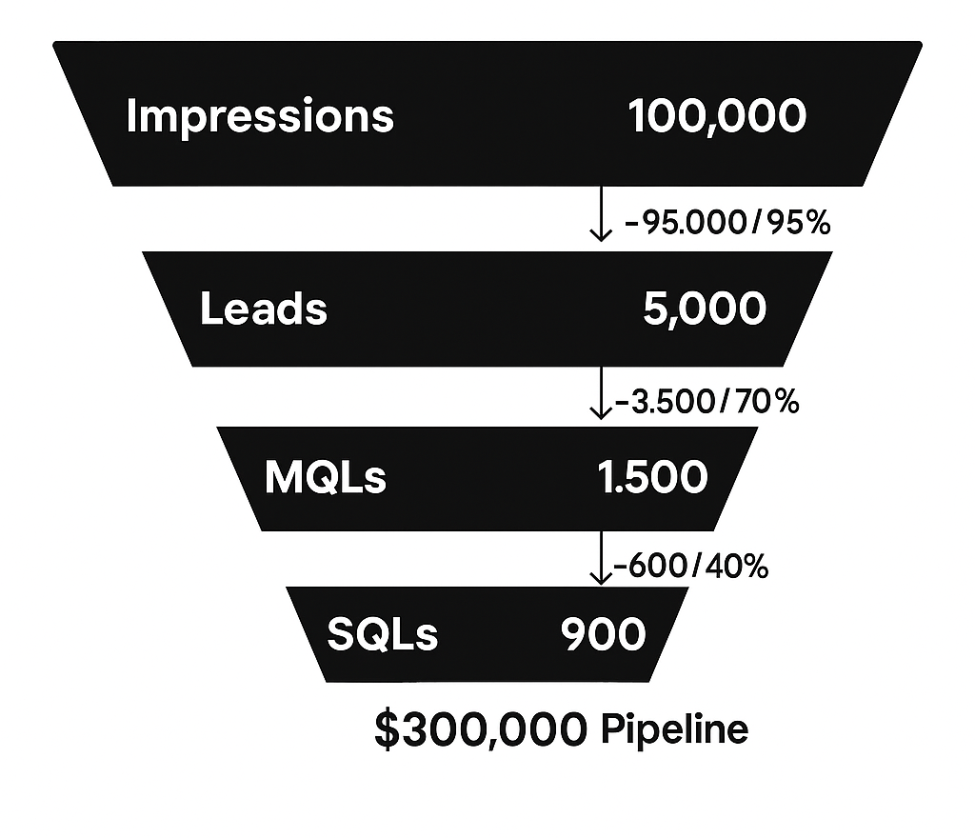
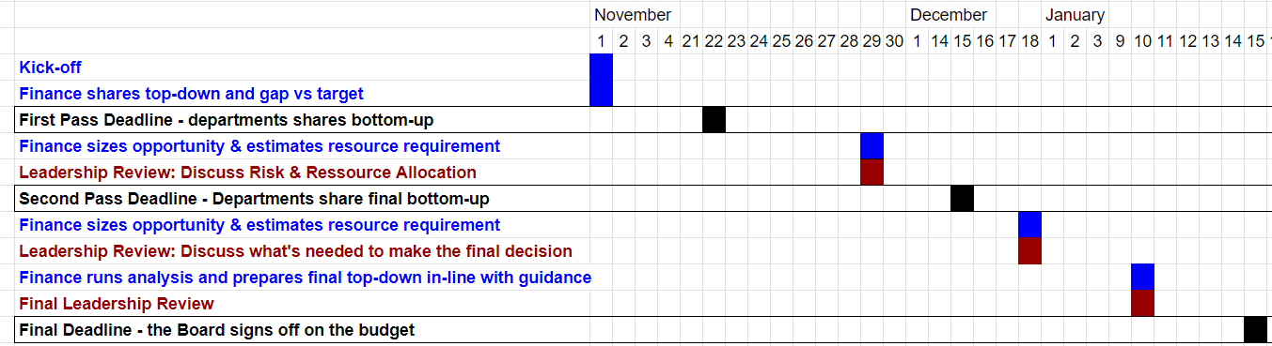
Funnel health snapshot
Include a brief summary of the wins and leaks within the funnel, plus your plans to capitalize on the wins and address any leaks.

Slide 13
Brand & awareness metrics
Metric | % +/- previous period | Commentary
E.g. Share of voice | +10% | Provide context behind the win/shortfall
E.g. Direct traffic | +2%
E.g. Branded search | -3.5%
E.g. Social engagement | +1%
E.g. Earned media coverage | -17%

Slide 14
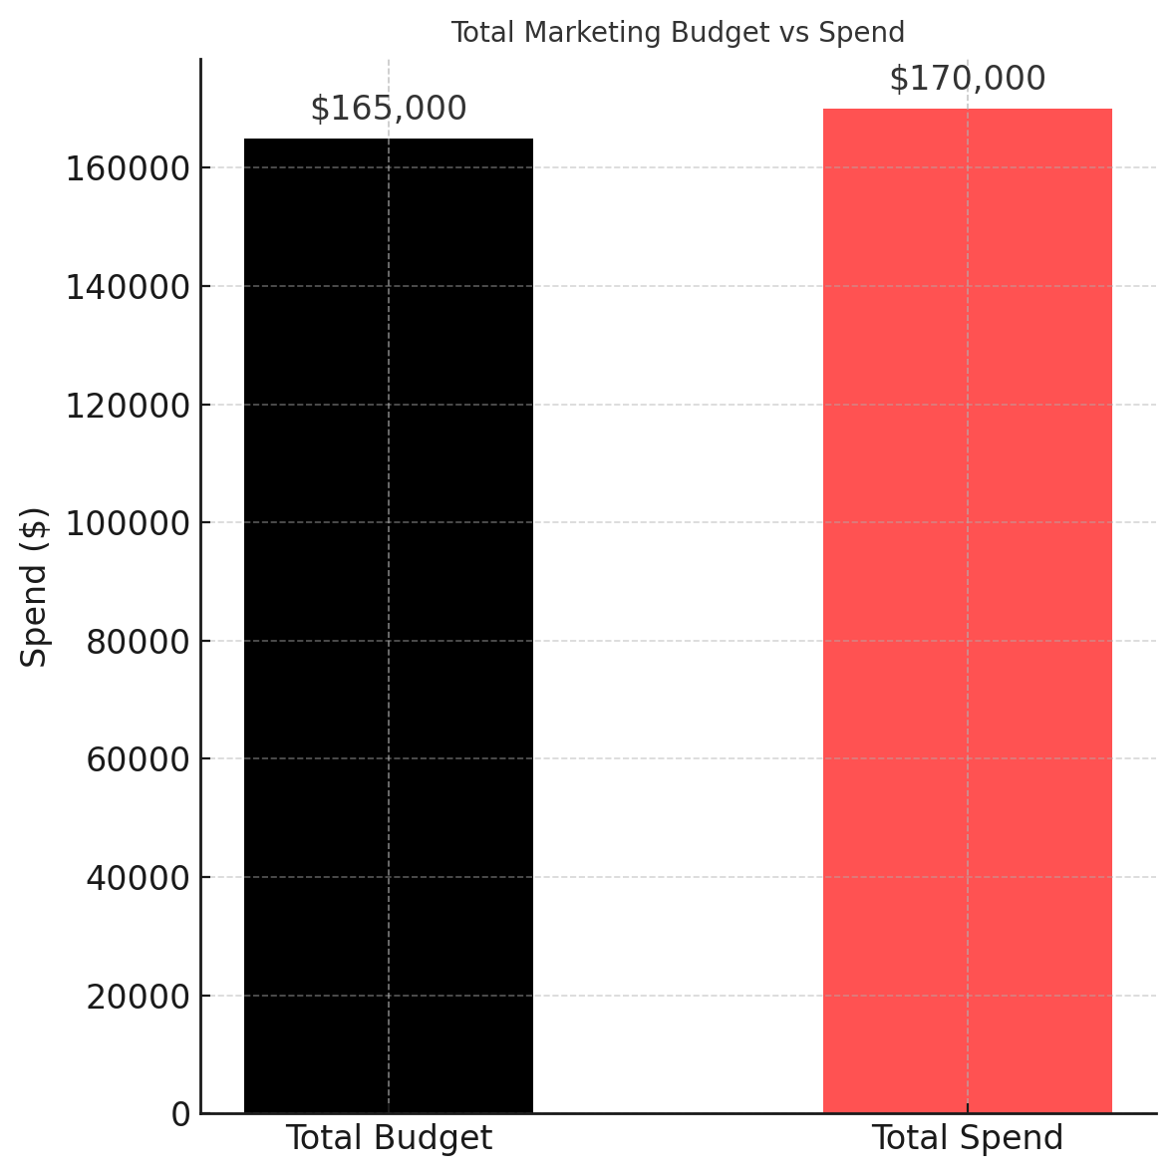
Budget vs actual
Include a brief overview of how much under/over budget you were, plus commentary on what drove those variances.

Slide 15
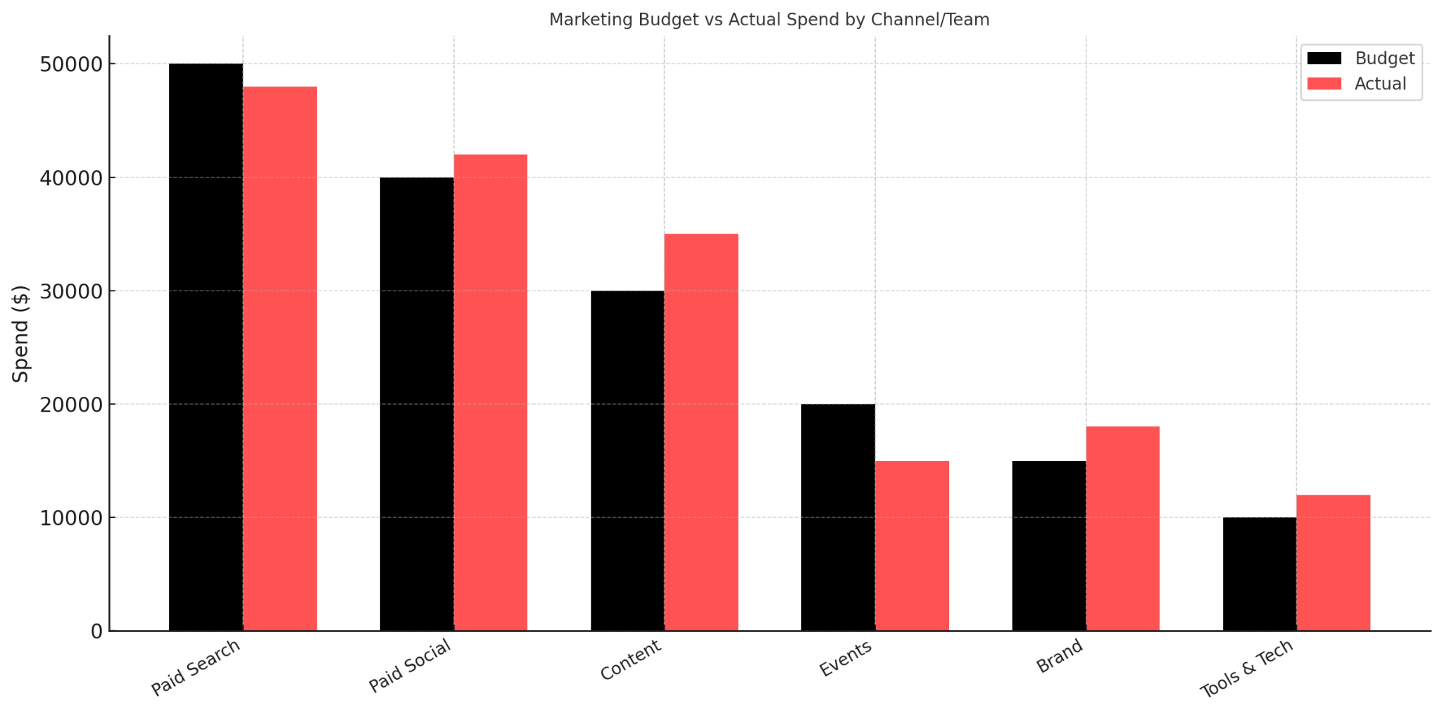
Budget & spend breakdown

Slide 16
What’s working
Paid Social (LinkedIn + Meta)
- CPL down 18% QoQ
- Strong performance with mid-funnel video content
Product-led content
- “How-to” guides driving 3x average time on page
- SEO traffic up 27% from bottom-funnel posts
Sales enablement assets
- Case study deck + ROI calculator credited in 32% of closed/won deals

Slide 17
What’s not working
Lead scoring model
- Over-qualifying low-intent leads — 42% rejected by SDR team
-Currently under revision with RevOps
Email nurture journey
- Low open rates (<15%) across 3 key segments
- Refresh in progress: updating content + A/B testing subject lines
Paid search (branded + competitor)
- CPCs up 40% with no corresponding conversion uplift
- Budget re-allocated to higher-performing channels

Slide 18
Upcoming priorities (next 90 days)
Bullet summary of key initiatives in flight or upcoming
E.g. “Revamp lead scoring model”
E.g. “Launch new content pillar”
E.g. “Hire Head of Growth”

Slide 19
Risks & dependencies
Be transparent: highlight anything that could block growth
E.g. “Engineering delay on product feature”
E.g. “Dependence on agency delivery”
E.g. “Hiring freeze risk”

Slide 20
Asks & recommendations
Additional headcount
Budget flexibility
Cross-functional support
We're at capacity producing high-impact content. A senior hire will allow us to scale thought leadership and bottom-funnel assets, both of which are currently bottlenecks for pipeline acceleration.
Paid Search has become inefficient (CPCs up 40%, lower conversion rates). We’re seeing stronger ROI in Paid Social and Partner Campaigns. A flexible budget will allow us to double down on what’s working without waiting for the next quarterly review.
Lead scoring and attribution need alignment. Current friction between marketing-qualified leads and SDR acceptance is affecting pipeline velocity. We’re requesting dedicated RevOps time to co-own the redesign of our lead qualification process.

